Slide 1














Loan Default
Risk Analysis
(Dataset : Loan Dataset)
(Last updated : 13-July-2025)

Slide 2
Dataset Overview
Conduct Exploratory Data Analysis (EDA)
Project’s Agenda
Visualization
Chi² test & Cramér’s V Test
Loan Prediction
Conclusions

Slide 3
Dataset Overview
01
02
03
Total Records: 32,586
Target Variable: loan_status_clean
✅ Non-Default: 25,586 (~79%)
❌ Default: 6,819 (~21%)
Features:
Numerical: age, income, loan amount, interest rate, employment years
Categorical: home ownership, loan intent, loan grade, etc

Slide 4
Exploratory Data Analysis (EDA)
01
02
03
04
05
Target Variable Distribution:
Default: 6,819 (≈ 21%)
Non-Default: 25,589 (≈ 79%)
Distribution Checks:
customer_age, customer income, loan_amount, loan_int_rate.
Detected right skew in all except interest rate(normal)
Data Types:
Categorical: home ownership, loan intent, loan grade.
Numerical: age, income, interest rate, loan amount
Outliers detected:
In customer_income, loan_amnt, and customer_age
Initial Patterns Identified:
Younger borrowers = slightly higher default rate
High income = lower risk of default
Larger loan amounts (20k+) associated with higher default
Loan Purpose affects risk — e.g., Medical & Debt Consolidation = high default

Slide 5
Visualization

Slide 6
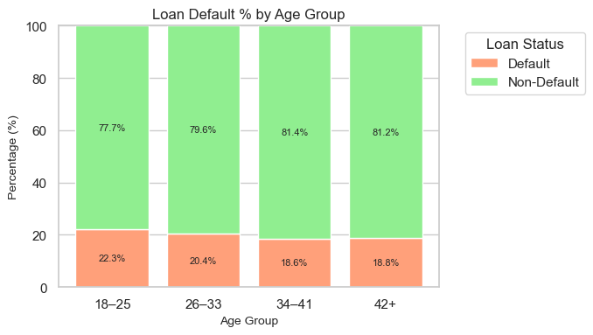
Age Group vs Loan Status
Insight:
Default rate slightly decreases as age increases — younger borrowers (18–25) show highest risk.
Borrowers aged 34+ are more stable — lowest default rates and better repayment behavior.

Slide 7
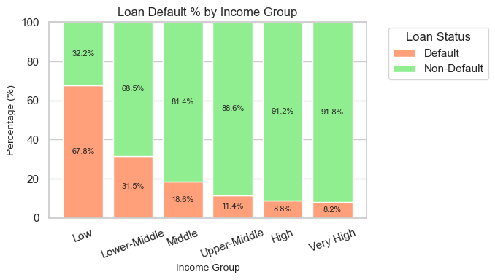
Income Group vs Loan Status
Insight:
Default rate drops steadily as income increases.
Low-income borrowers show highest defaults — financial stress.

Slide 8
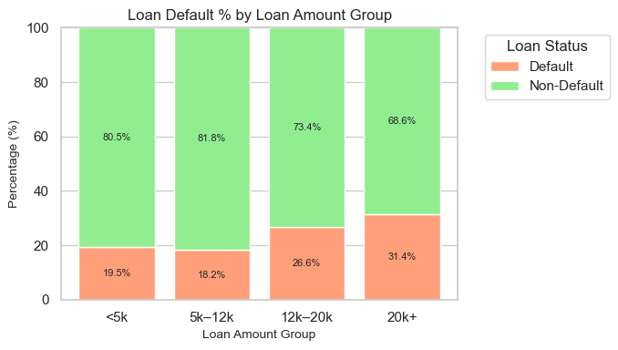
Loan Amount Group vs Loan Status
Insight:
Up to 12k: Default rate stays low and steady — borrowers likely manage repayment well.
Above 12k: Default risk rises quickly — larger loans bring more pressure and missed payments.

Slide 9
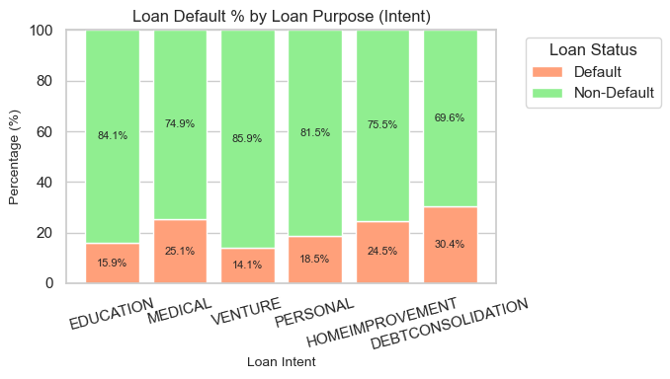
Loan Intent vs Loan Status
Insight:
Lowest default rates in Education and Venture loans — borrowers tend to repay better.
Highest risk seen in Debt Consolidation, Medical, and Home Improvement — likely tied to urgent or unstable financial situations.

Slide 10
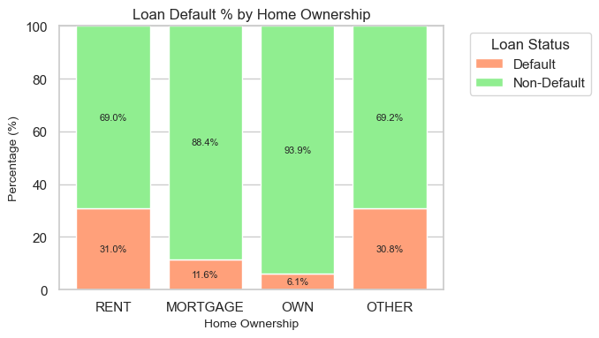
Home Ownership vs Loan Status
Insight:
Own & Mortgage holders show the lowest default rates — stable living situations help repayment.
Renters & Others face higher risk — financial uncertainty may impact loan reliability.

Slide 11
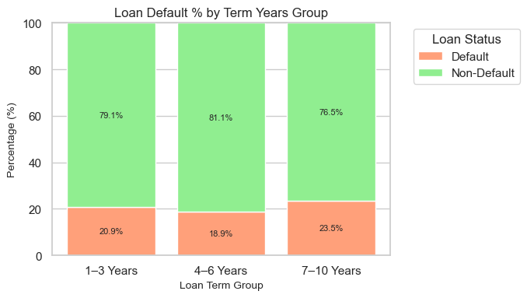
Term Years Group vs Loan Status
Insight:
4–6 year loans have the lowest default rate — repayment feels more balanced.
Short (1–3 yrs) and long (7–10 yrs) terms show higher defaults — either too rushed or stretched too long.

Slide 12
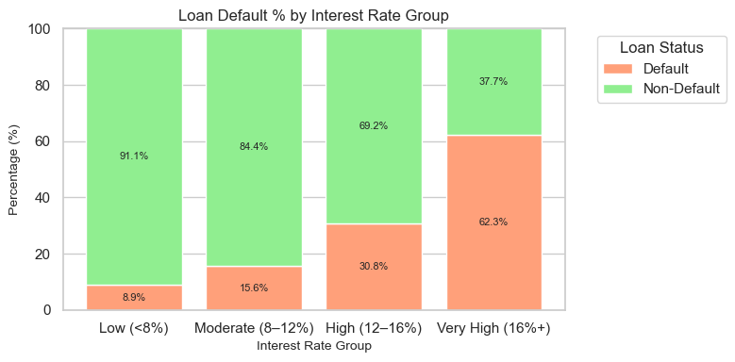
Interest Rate Group vs Loan Status
Insight:
Borrowers with Very High interest rates are most likely to default.
Suggests that higher rates may burden borrowers, especially those already flagged as risky

Slide 13
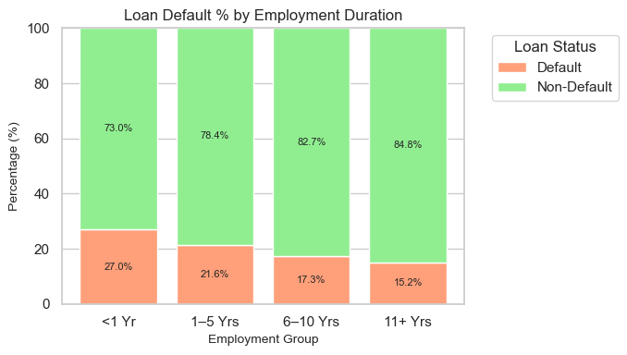
Employment Group vs Loan Status
Insight:
Default rate decrease as job duration increases — people with longer work history repay more reliably.
Shortest employment group (<1 year) shows highest risk — stability matters in financial commitments

Slide 14
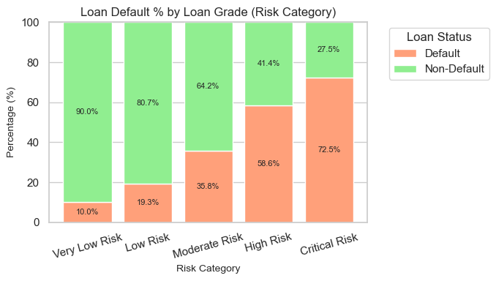
Loan Grade Named vs Loan Status
Insight:
Default risk rises sharply from Very Low to Critical grades — high-risk loans see over 70% defaults.
Safer lending happens in Very Low and Low grades — borrowers repay reliably.

Slide 15
Chi-square Test
🔍 Purpose:
To check whether two categorical variables are independent or associated.
Basic Idea:
It compares the observed frequencies with the expected frequencies in a contingency table.
If p-value < 0.05 → Reject Null Hypothesis → Relationship exists
If p-value ≥ 0.05 → Fail to reject Null → No relationship
Cramer’s V Test
🔍 Purpose:
After Chi-Square confirms the relationship, Cramér’s V tells how strong that relationship is (magnitude).
Basic Idea:
It uses the Chi-Square statistic and adjusts it to give a value between 0 and 1.
0.00 → No association
0.01 – 0.10 → Weak association
0.10 – 0.30 → Moderate association
0.3–0.50 → Strong association
>0.5 → Very strong association

Slide 16
Chi-Square Test & Cramér’s V Test Results
Feature
p-value
Cramér’s V
Association with Loan Status
Interpretation
Age Group
< 0.0001
0.032
Weak Association
Age has minimal impact on loan default; not a strong predictor.
Income Group
< 0.0001
0.293
Moderate Association
Borrower income is moderately associated with default behavior.
Loan Amount Group
< 0.0001
0.094
Weak Association
Loan amount has weak influence on default probability.
Loan Intent Group
< 0.0001
0.142
Moderate Association
Loan purpose moderately affects chances of default.
Loan Grade Named
< 0.0001
0.373
Strong Association
Loan grade is a strong predictor of loan default risk.
Home Ownership
< 0.0001
0.251
Moderate Association
Home ownership status shows strong relation to repayment behavior.
Employment Group
< 0.0001
0.093
Weak Association
Employment duration shows limited effect on default.
Term (Years) Group
< 0.0001
0.044
Weak Association
Loan term length has a weak association with default status.
Loan Interest Rate Group
< 0.0001
0.323
Strong Association
Higher interest rates strongly relate to increased default risk.

Slide 17
Loan Prediction

Slide 18
Model Selection
Two models used for classification:
🔹 Logistic Regression (baseline)
🔹 Random Forest (advanced, tree-based)
Both trained on:
Cleaned & engineered features
OneHot + Scaled inputs
80/20 train-test split (32K+ records)

Slide 19
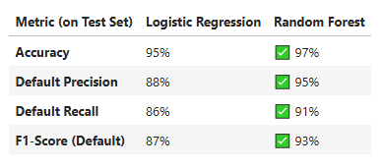
Model Evaluation Metrics & Performance comparison
Accuracy → Overall correct predictions
Precision → Out of predicted defaulters, how many were correct?
Recall → Out of all actual defaulters, how many were caught?
F1-Score → Balance between precision & recall (risk control)

Slide 20
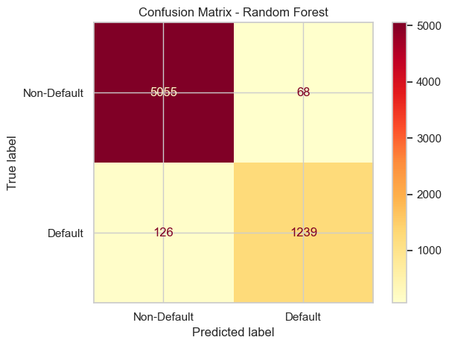
Confusion Matrix – Random Forest Model
Insights:
Correct predictions: 6294 cases.
Wrong predictions: 194 cases.

Slide 21
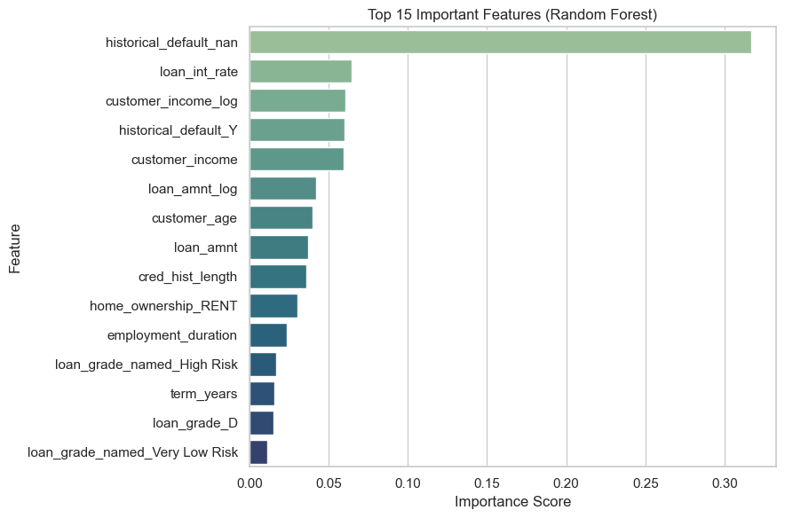
Top Predictive Features – Random Forest Model
Insights:
Most important: historical_default_nan stands out as the key driver, holding nearly 30% of total importance.
Next top group: Features like loan_int_rate, customer_income_log, and historical_default_Y each contribute around 10% importance.

Slide 22

📊 EDA and Visualization revealed key risk groups, including low-income borrowers, young applicants, and larger loan amounts
🧠 Statistical tests confirmed strong associations between default risk and features like loan grade, home ownership, and interest rate
Conclusion
⚙️ Random Forest model delivered 97% accuracy, correctly identifying 91% of actual defaulters with strong reliability
🚀 The model is ready for real-world use to enhance loan approval processes and reduce financial risk exposure

Slide 23
Thank you
Any Question?

